Slide 1
European AI Challenge 2026: From Data to Policy
Presentation of the datasets
Martin Jančovič, DG JRC E1, Disaster Risk Management - External consultant for the European commission (KAJO)
Thomas Saillour, DG JRC E1, Disaster Risk Management - Coastal Floods
Olesya Grabova, DG JRC S4, Science for Policy

Slide 2
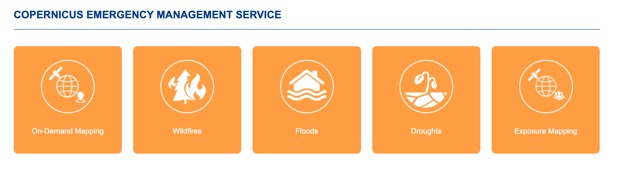
Copernicus Emergency Management Service (CEMS)
https://emergency.copernicus.eu/

Slide 3
Floods
EFAS European Flood Awareness System
Flood hazard maps
https://data.jrc.ec.europa.eu/collection/id-0054
Notes:
Cover slide

Slide 4
CEMS-EFAS flood hazard
Google Cloud folder | cems-efas
Dataset | EFAS river flood hazard maps for Europe. Resolution 3 arc-second (~90 m) grid
What it is | Model-based maps of how deep the water gets in a 10-year, 100-year and 500-year river flood, for the whole of Europe.
Answers | Where does a model expect water in a 10-, 100-, 500-year river flood?
Data type | Raster (water depth in meters)
Format and size | 3 GeoTIFFs, 0.95 GB in total RP10, RP100, RP500
Return Periods?
Recurrence interval = (n+1) / m
  n number of years on record;
  m is the number of observed occurrences
The theoretical return period between occurrences is the inverse of the average frequency of occurrence
Simple terms:
  RP500 X an event that occurs every 500 years
  RP500 = an event that has 1/500=0.002 or 0.2% probability of occurring this year
4

Slide 5
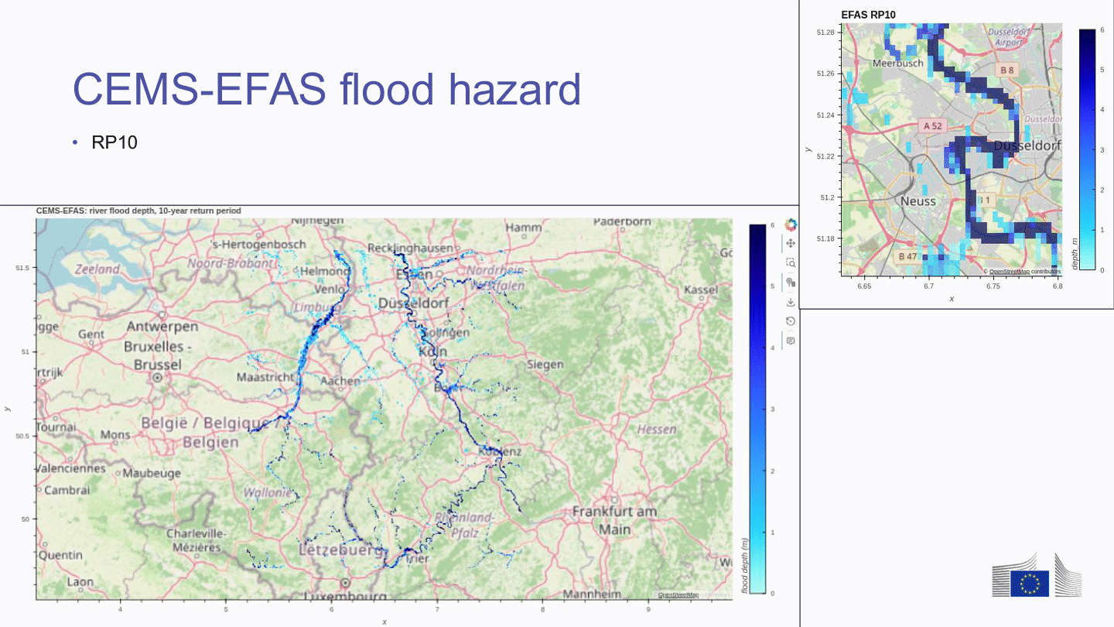
5

Slide 6
Exposure Mapping
GHSL Global Human Settlement Layer
Population Grid (POP)
https://data.jrc.ec.europa.eu/dataset/2ff68a52-5b5b-4a22-8f40-c41da8332cfe
Notes:
Cover slide

Slide 7
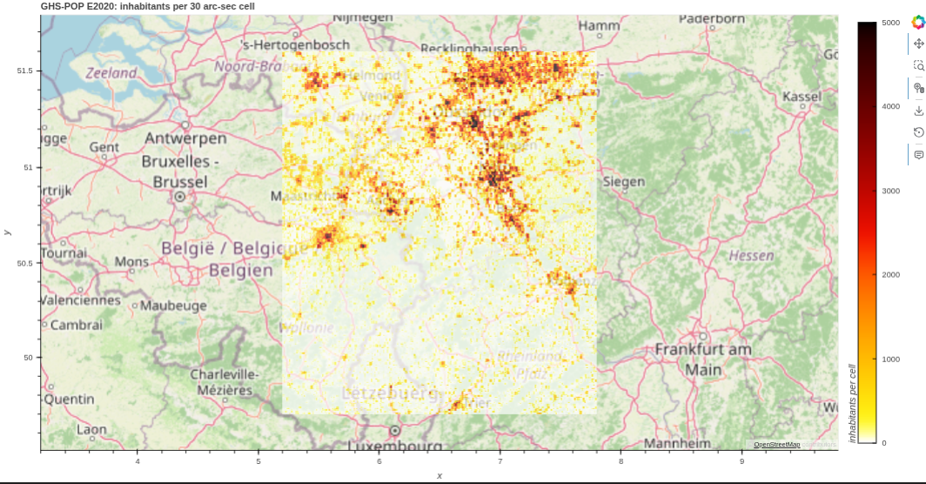
GHS-POP
Google Cloud folder | ghs_pop
Dataset | GHS-POP R2023A
What it is | Estimated number of residents per grid cell, for the years 2020 and 2025 (projection)
Answers | How many residents per grid cell?
Data type | Raster (people per cell)
Format and size | 2 GeoTIFFs of about 0.5 GB (2020 and 2025), each with an overview file (.ovr), a PDF and an Excel file
7

Slide 8
Exposure Mapping
GHSL Global Human Settlement Layer
Open Building attribute table (OBAT)
https://data.jrc.ec.europa.eu/dataset/f41a22f1-5741-4c41-86eb-6384654f6927
Notes:
Cover slide

Slide 9
GHS-OBAT
Google Cloud folder | obat_be, obat_de, obat_nl
Dataset | GHS-OBAT R2024A
What it is | One record per building: location, use (residential or not) and, where known, height and construction period. Reference year 2020.
Answers | Which buildings were there, and are they residential?
Data type | Vector (one point per building), reference year 2020. Fields: location, use, and where known height and construction period
Format and size | One GeoPackage plus a PDF per country: BE 1.44 GB, NL 2.23 GB, DE 8.58 GB
Details
1 GeoPackage per country (GER, NL, BE)
  7.5 M points for BE
  44.1 M points for DE
  11.8 M points for NL
Coded fields, per the GHS-OBAT R2024 documentation:
  `height`:mean building height (m), from GHS-BUILT-H ANBH, lower-bounded at 2.5 m
  `use`: 0 outside built-up domain, 1 residential, 2 non-residential
  `epoch`: construction epoch: 0 outside, 1 `<1980`, 2 `1980-1990`, 3 `1990-2000`, 4 `2000-2010`, 5 `2010-2020`
  `shapefactor`: surface-to-volume ratio (m²/m³), inversely proportional to building size
  `area`, `perimeter`: footprint area (m²) and perimeter (m), computed in the local UTM zone
  `adm1`: GADM level-1 administrative unit
9

Slide 10
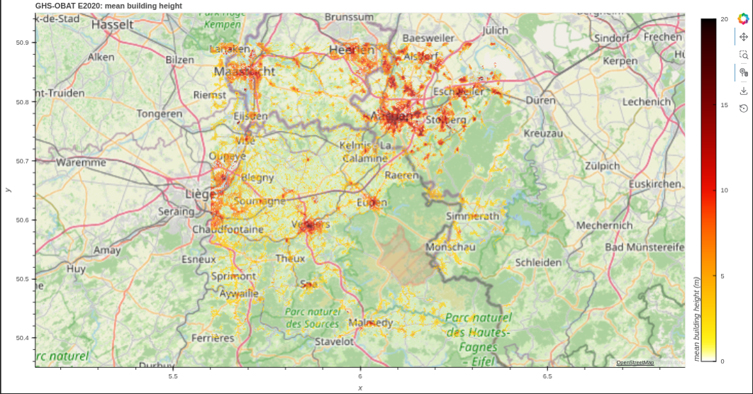
GHS-OBAT
10

Slide 11
On Demand Mapping
Flood maps activations
https://mapping.emergency.copernicus.eu/

Slide 12
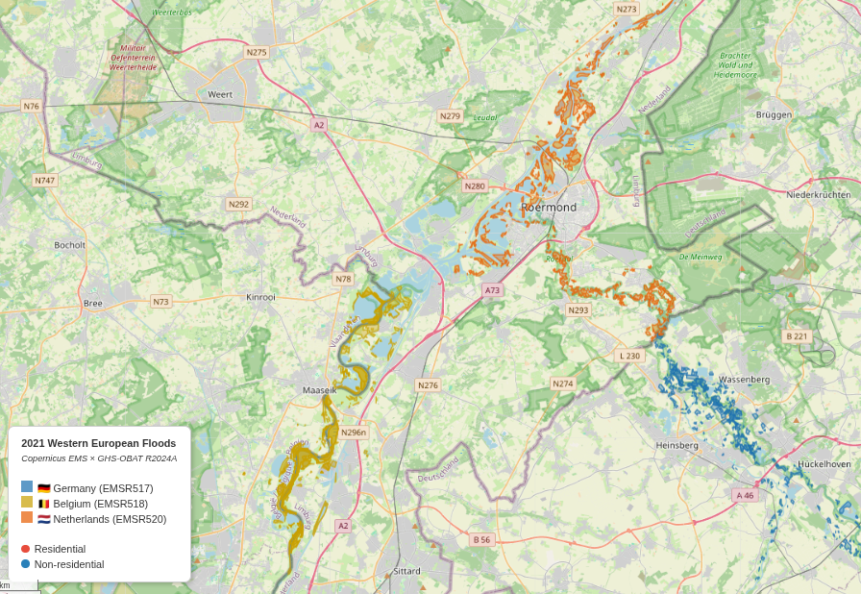
Flood maps activations
Google Cloud folder | ems_be, ems_de, ems_nl
Dataset | CEMS Rapid Mapping (activations EMSR518 BE, EMSR517 DE, EMSR520 NL)
What it is | Flood maps drawn by analysts from satellite images during the 2021 floods: where the water was and which buildings were hit.
Answers | Where was the water, as seen by satellite?
Data type | Vector: polygons, points, lines drawn by analysts from satellite images
Format and size | One folder per product, with shapefiles plus JSON, KMZ and XML copies: BE 4 products (0.39 GB), DE 22 (0.54 GB), NL 1 (0.06 GB)
12

Slide 13
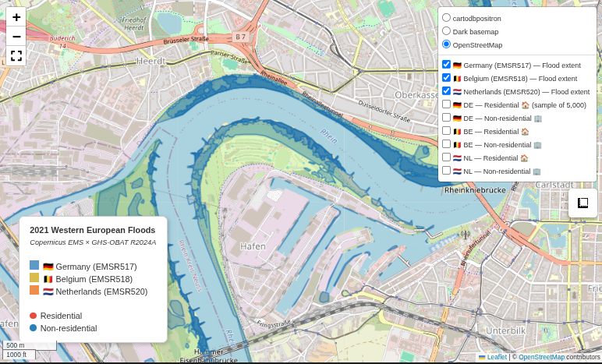
Flood maps activations – zoom
13

Slide 14
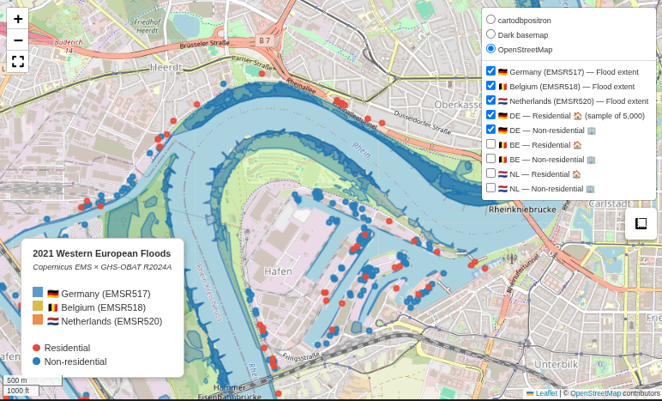
Combine information
14

Slide 15


Get the slides https://gist.github.com/MartinMIB-BA/45e8075ee8cd87e6137ff28aeeb5ed84
Get the data (Google Cloud) https://console.cloud.google.com/storage/browser/datasets_challenge/working_data

Slide 16
Thank you
Notes:
More information in the Reuse guidelines: eceuropaeu.sharepoint.com/sites/intellectual-property/SiteAssets/Forms/AllItems.aspx?id=%2Fsites%2Fintellectual-property%2FSiteAssets%2FSitePages%2FGuides-and-Manuals%2F2019_Reuse-guidelines%28CC-BY%29_Jan2022%2Epdf&parent=%2Fsites%2Fintellectual-property%2FSiteAssets%2FSitePages%2FGuides-and-Manuals

